Slide 1

Convolutional Neural Networks
aCubeIT
L01 - Deep Learning for Life Sciences Course

Slide 2
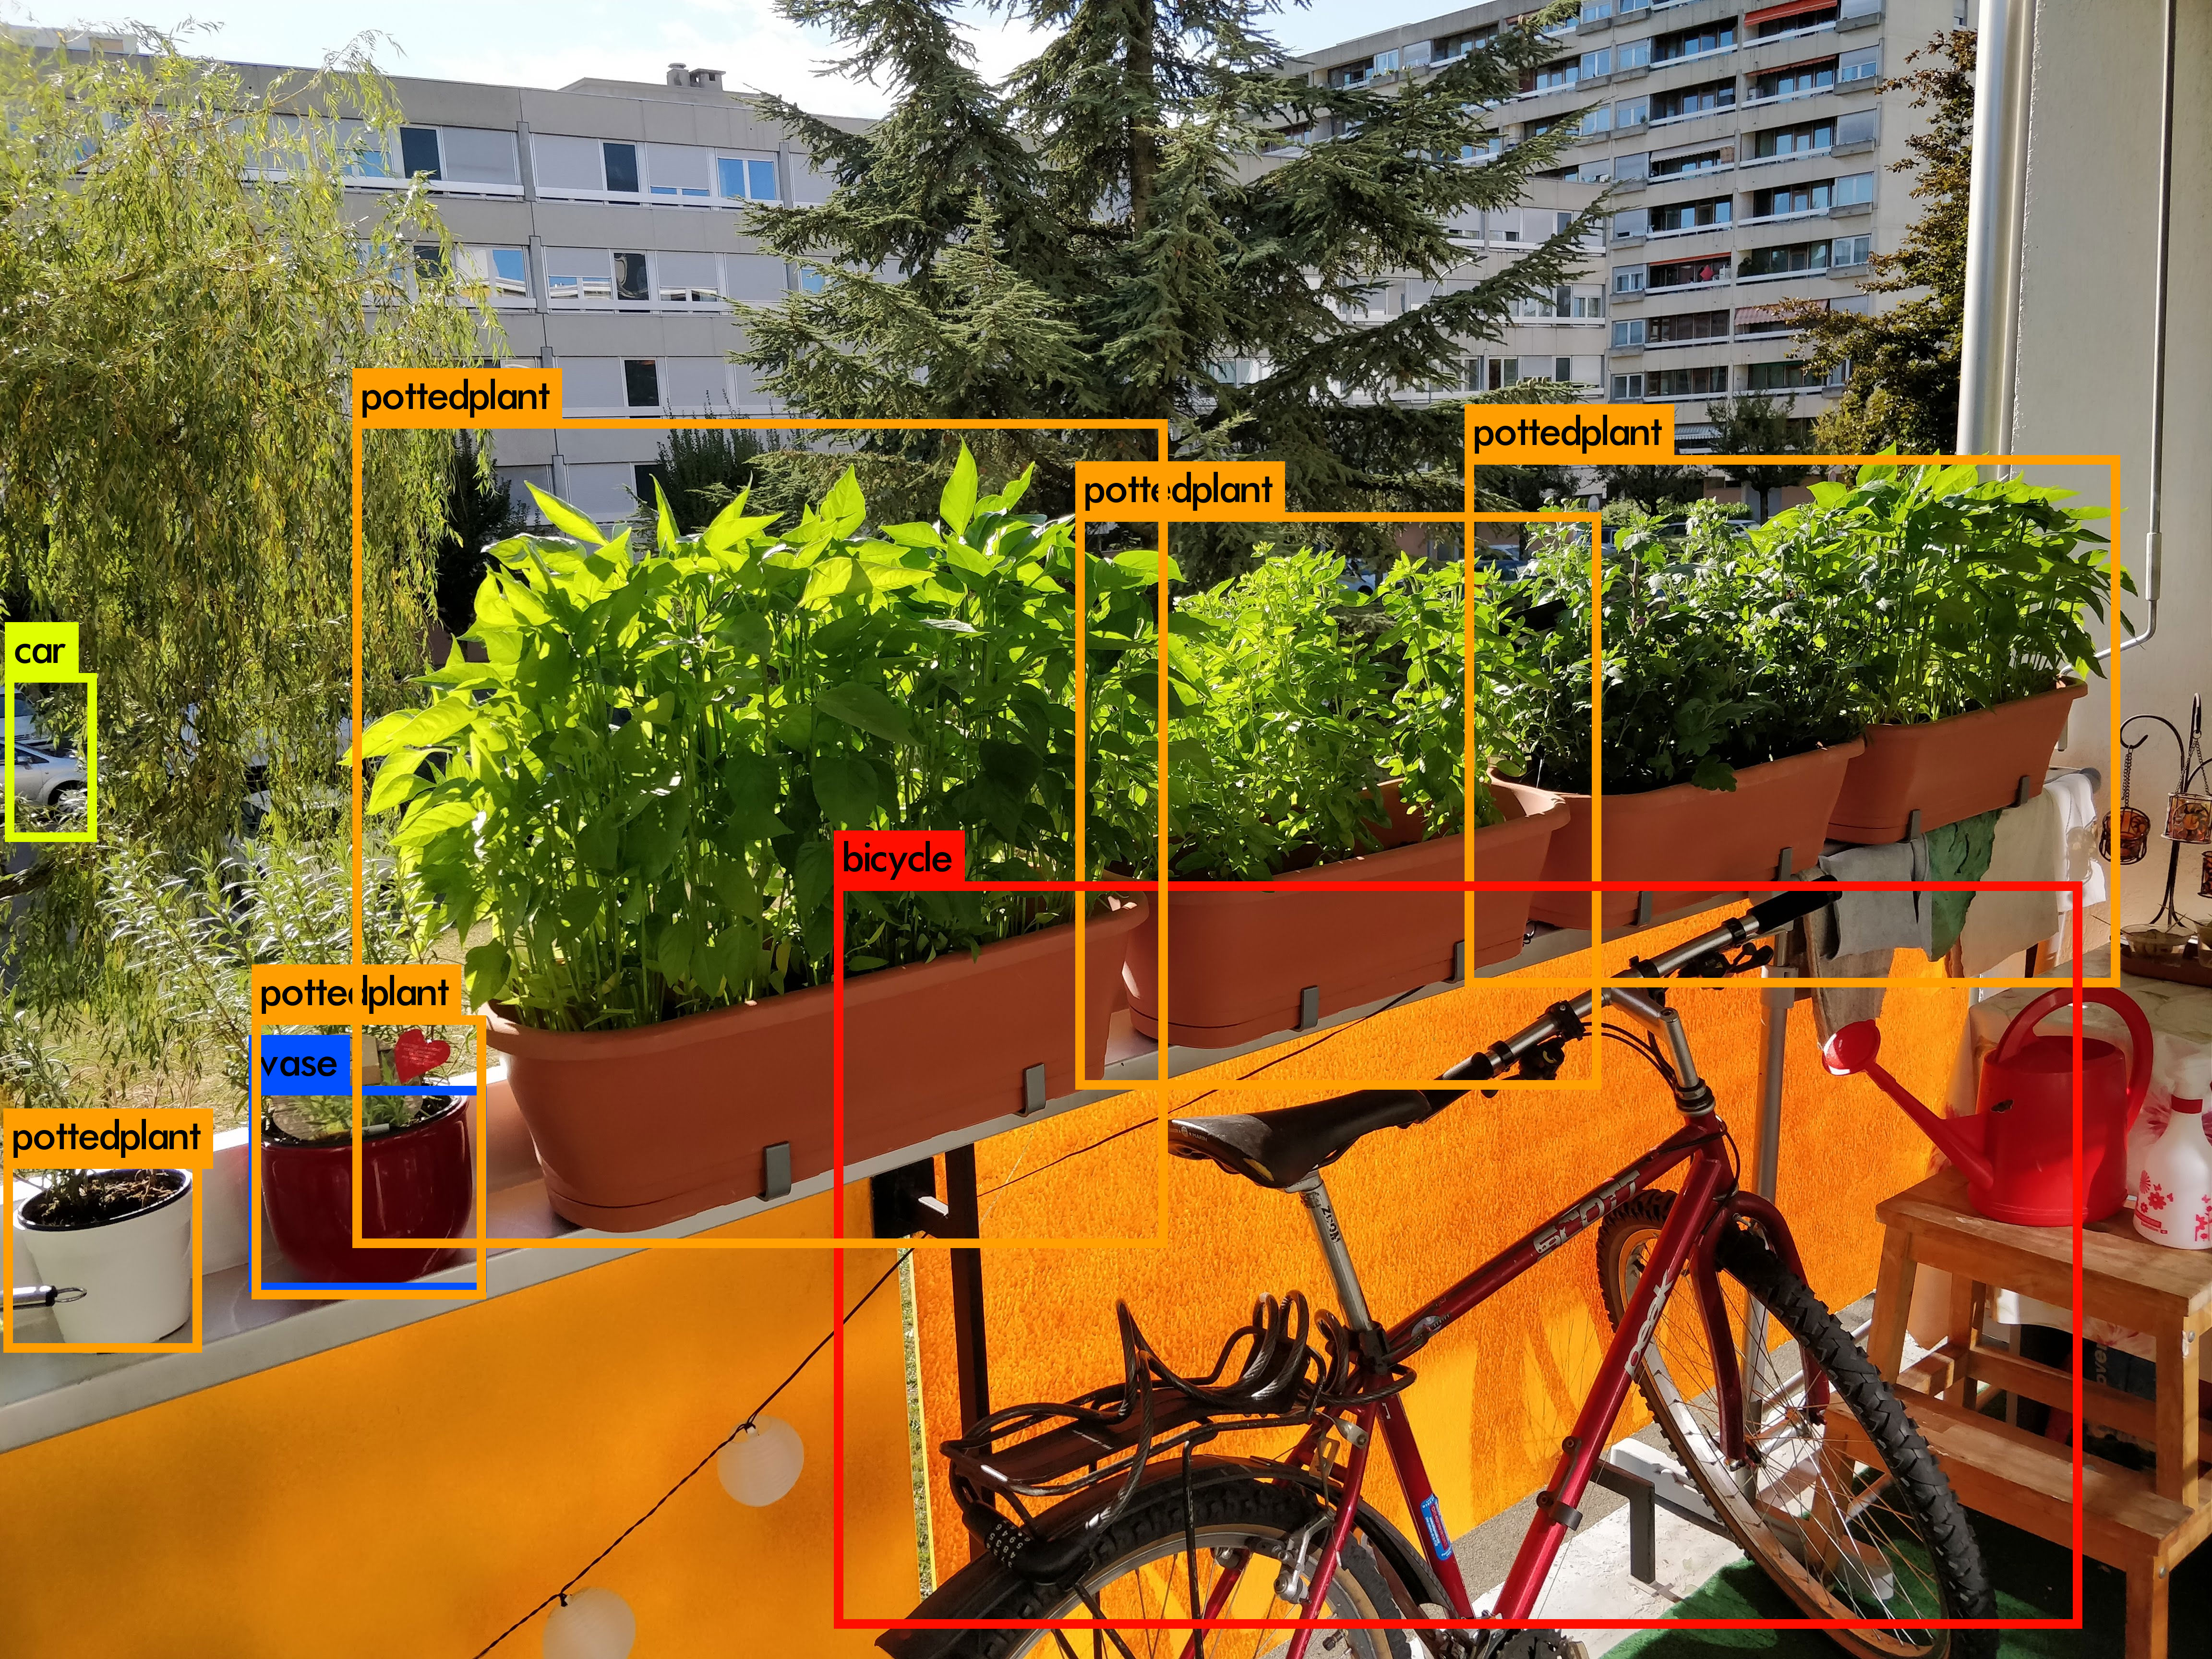
Convolutional Neural Networks (CNNs)
Visual Recognition
Redmon et al., 2016. You only look once: unified, real-time object detection.

Slide 3
Convolutional Neural Networks (CNNs)
Facial Identification
Medical Image Analysis
Drug Design
Visual Recognition

Slide 4
High-Level Feature Extraction
Can you identify key features in each image category ?
Eyes
Nose
Lips
Wheels
Windshields
Headlights
Doors
Windows
Roofs

Slide 5
Manual Feature Extraction
Traditional Rule-Based Methods:
Domain Knowledge
→
Define Features
→
Detect Features to Classify
Problems ?
Viewpoint variation
Scale variation
Occlusion
Deformation
Background clutter
Illumination conditions
Variation
Etc

Slide 6
Convolutional Neural Networks (CNNs)
Solution
Make the machine learn the features by itself
Take into account the spatial proximity of features
Convolutions

Slide 7
Sliding Window
Input
ada love

Slide 8
Sliding Window
Input
Feature Map
a
ada love
ada love
Filter

Slide 9
Sliding Window
Input
Feature Map
a
ada love
ada love
Filter

Slide 10
Sliding Window
Input
Feature Map
a
ada love
ada love
Filter

Slide 11
First-Layer Convolution
We use filters to extract local features.
Input
Filter
Feature Map
ada lovelace was a mathematician and writer who lived in the 19th century. lovelace holds the honor of having published the very first algorithm intended to be used by a machine to perform calculations, which make lovelace the first-ever computer programmer.
a a a a a a a a a__ ______ ___ ____ ___ ___ ____ ________ _____a__ _____ ___ _____ __ _a____ _________ ___ ____ _____ a________ ________ __ __ ____ __ a _a_____ __ _______ _a____a______ _____ _a__ _____a__ ___ __________ ________ _____a_____
a

Slide 12
First-Layer Convolution
We use filters to extract local features.
Input
Filter
Feature Map
ada lovelace was a mathematician and writer who lived in the 19th century. lovelace holds the honor of having published the very first algorithm intended to be used by a machine to perform calculations, which make lovelace the first-ever computer programmer.
_d_ ________ ___ _ _____________ __d ______ ___ ____ d__ ___ ____ ________ ________ ___d_ ___ _____ __ ______ ________d ___ ____ _____ _________ _____d_d __ __ ___d __ _ _______ __ _______ _____________ _____ ____ ________ ___ __________ ________ ___________
d

Slide 13
Second-Layer Convolution
First-Layer Filters:
a
d
We use multiple filters to extract different features.
a a a a a a a a a__ ______ ___ ____ ___ ___ ____ ________ _____a__ _____ ___ _____ __ _a____ _________ ___ ____ _____ a________ ________ __ __ ____ __ a _a_____ __ _______ _a____a______ _____ _a__ _____a__ ___ __________ ________ _____a_____
Stacked First-Layer Feature Maps
_d_ ________ ___ _ _____________ __d ______ ___ ____ d__ ___ ____ ________ ________ ___d_ ___ _____ __ ______ ________d ___ ____ _____ _________ _____d_d __ __ ___d __ _ _______ __ _______ _____________ _____ ____ ________ ___ __________ ________ ___________
ada lovelace was a mathematician and writer who lived in the 19th century. lovelace holds the honor of having published the very first algorithm intended to be used by a machine to perform calculations, which make lovelace the first-ever computer programmer.
ada
ada
Input
Filter
Second-Layer Feature Map
Notes:
- Higher levels: combination of features

Slide 14
Third-Layer Convolution
First-Layer Filters:
a
d
l
o
v
e
c
Stacked Feature Maps
a a a a a a a a a__ ______ ___ ____ ___ ___ ____ ________ _____a__ _____ ___ _____ __ _a____ _________ ___ ____ _____ a________ ________ __ __ ____ __ a _a_____ __ _______ _a____a______ _____ _a__ _____a__ ___ __________ ________ _____a_____
_d_ ________ ___ _ _____________ __d ______ ___ ____ d__ ___ ____ ________ ________ ___d_ ___ _____ __ ______ ________d ___ ____ _____ _________ _____d_d __ __ ___d __ _ _______ __ _______ _____________ _____ ____ ________ ___ __________ ________ ___________
_d_ ________ ___ _ _____________ __d ______ ___ ____ d__ ___ ____ ________ ________ ___d_ ___ _____ __ ______ ________d ___ ____ _____ _________ _____d_d __ __ ___d __ _ _______ __ _______ _____________ _____ ____ ________ ___ __________ ________ ___________
_d_ ________ ___ _ _____________ __d ______ ___ ____ d__ ___ ____ ________ ________ ___d_ ___ _____ __ ______ ________d ___ ____ _____ _________ _____d_d __ __ ___d __ _ _______ __ _______ _____________ _____ ____ ________ ___ __________ ________ ___________
_d_ ________ ___ _ _____________ __d ______ ___ ____ d__ ___ ____ ________ ________ ___d_ ___ _____ __ ______ ________d ___ ____ _____ _________ _____d_d __ __ ___d __ _ _______ __ _______ _____________ _____ ____ ________ ___ __________ ________ ___________
_d_ ________ ___ _ _____________ __d ______ ___ ____ d__ ___ ____ ________ ________ ___d_ ___ _____ __ ______ ________d ___ ____ _____ _________ _____d_d __ __ ___d __ _ _______ __ _______ _____________ _____ ____ ________ ___ __________ ________ ___________
ada lovelace was a mathematician and writer who lived in the 19th century. lovelace holds the honor of having published the very first algorithm intended to be used by a machine to perform calculations, which make lovelace the first-ever computer programmer.
_d_ ________ ___ _ _____________ __d ______ ___ ____ d__ ___ ____ ________ ________ ___d_ ___ _____ __ ______ ________d ___ ____ _____ _________ _____d_d __ __ ___d __ _ _______ __ _______ _____________ _____ ____ ________ ___ __________ ________ ___________
ada lovelace
ada lovelace
Input
Filter
Third-Layer Feature Map
Notes:
The specific features analysed at each layer help put the whole thing together

Slide 15
Convolutional Neural Networks (CNNs)
CNNs deal with greater complexity by having more layers.
Deep Learning

Slide 16
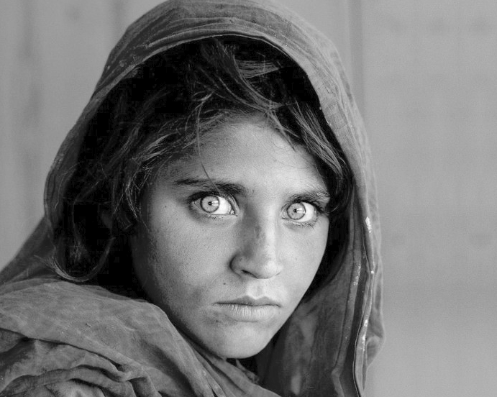
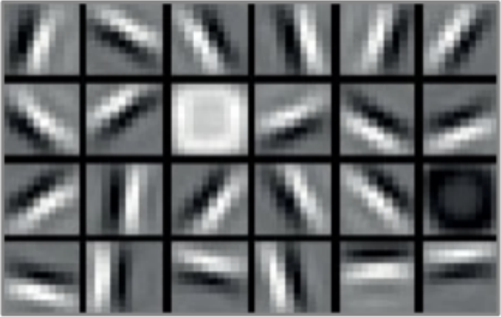
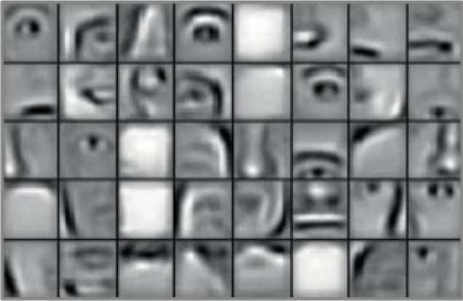
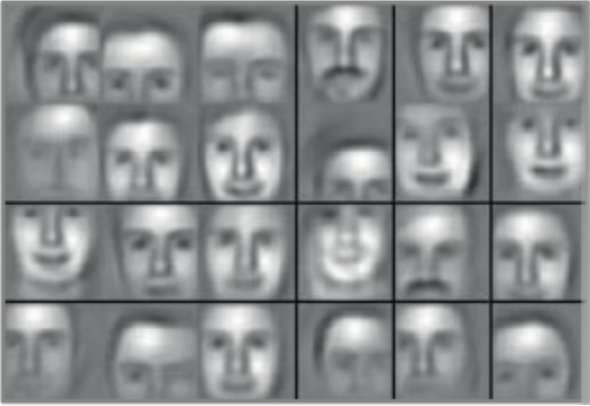
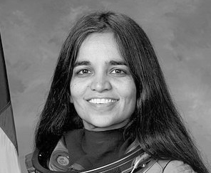
Convolutional Neural Networks (CNNs)
Input
Feature Maps
Raw Image(s)
Low-level
Mid-level
High-level
→
→
→
Edges
Spots
Ears
Eyes
Nose
Facial Structure
…
Filters
Notes:
At the end will condense all the info together and try and predict.

Slide 17
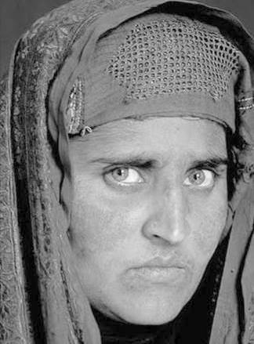
Convolutional Neural Networks (CNNs)
90%
Input
Feature Maps
10%
→
Low-level
→
Mid-level
→
High-level
→
…
Classification
Filters
Notes:
At the end will condense all the info together and try and predict.

Slide 18
Convolutional Neural Networks (CNNs)
Works well on data with spatial relationship
Translation invariant
Scale invariant
Dave Smith. 2018. Cutting-Edge Face Recognition is Complicated. These Spreadsheets Make it Easier. Medium, Towards Data Science.
Notes:
Advantages

Slide 19
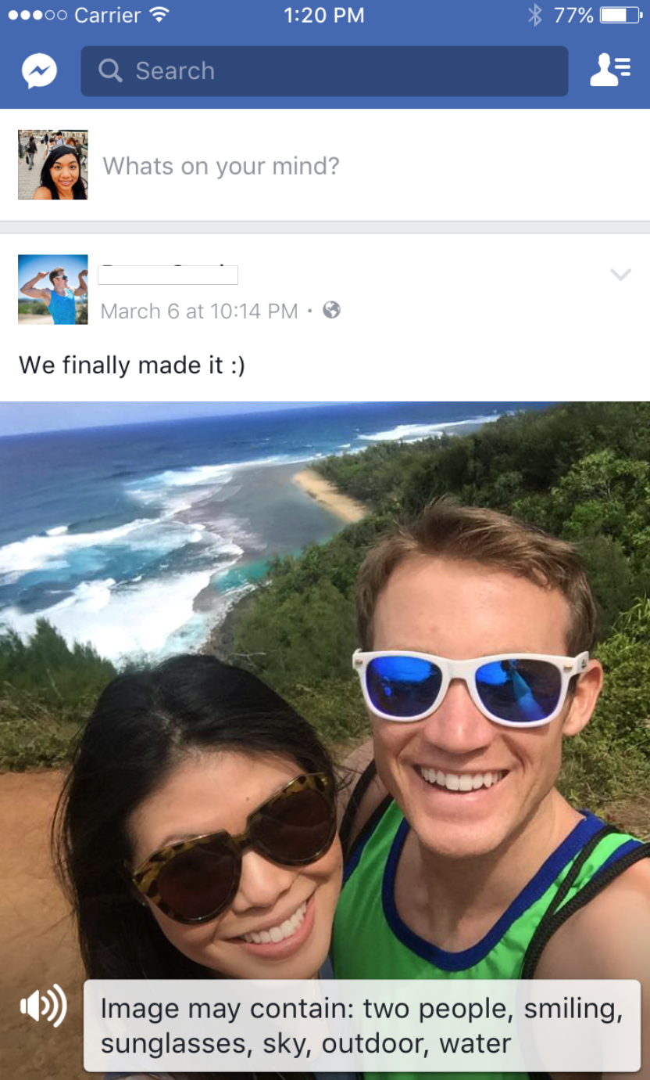
CNNs in Technology
Automatic image recognition and captioning
Used for visually impaired people
Wu et al., 2017, February. Automatic alt-text: Computer-generated image descriptions for blind users on a social network service. 2017 ACM Conference.

Slide 20
CNNs in Life Sciences
Medical Diagnosis
CheXNet:
21-layer CNN
Input: chest X-ray image
Outputs: probability of a pathology
Rajpurkar et al., 2017. Chexnet: Radiologist-level pneumonia detection on chest x-rays with deep learning.

Slide 21
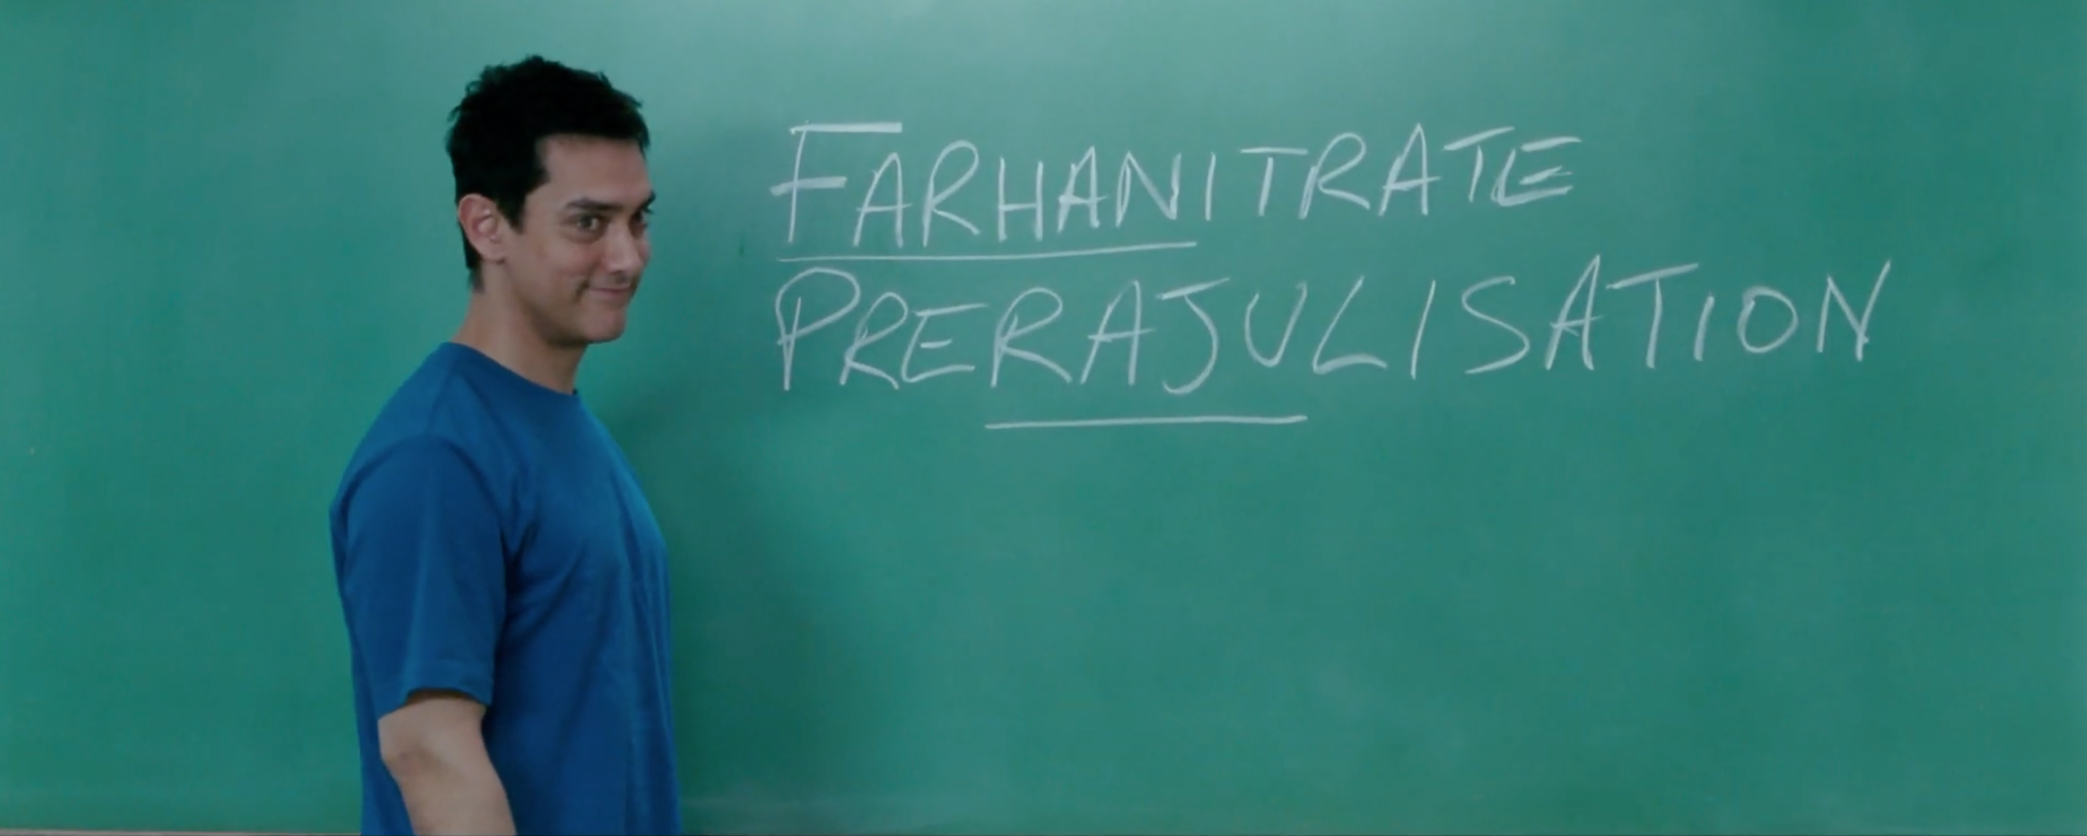
Summary
Visual recognition
Convolutions
Filters
Feature Maps
Architectures
Strides
Layers
Handling complexity

Slide 22
Thank you !
Ackruti Trade Center, MIDC, Mumbai, IND
www.acubeit.com
+91 9892512129
prakash@acubeit.com
aCubeIT

